Slide 1
Analysis of micro-instabilities impact on the electron temperature gradient length in NSTX pedestals
Presenter: Max T. Curie
Galina Avdeeva, Jason Parisi, Gary Staebler, David R. Hatch, Stefano Munaretto, Shelly Lei, Sterling Smith, Walter Guttenfelder, Mate Lampert, Oak Nelson, Tom Neiser, Joel Larakers, Stanley Kaye, Eric Fredrickson, Ahmed Diallo, Ehab Hassan, Michael Halfmoon, Joshua M Manela, Matthew M Tennery, NSTX team

Slide 2
Overview
Motivation
Approach
Results
Future works

Slide 3
Motivation
Case study using gyro-kinetic has found that micro-instabilities such as KBM, ITG, ETG, MTM existing in the NSTX pedestal.
A large sample sized study on such modes has not been conducted before.
This study will provide a statistical guidance on which the modes contribution different channel of transports.

Slide 4
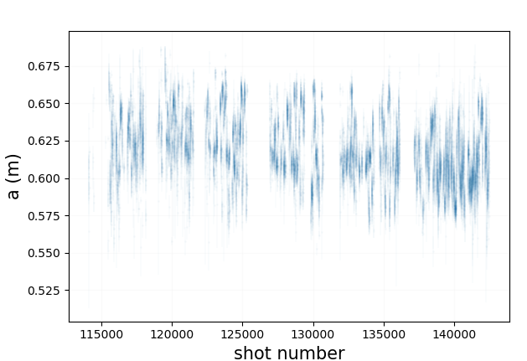
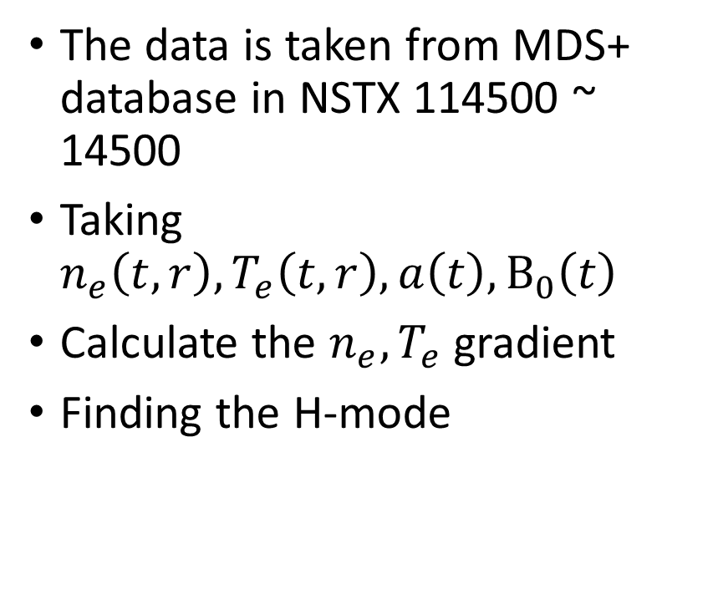
Data acquisition
The data is taken from MDS+ database in NSTX 114500 ~ 14500
Taking $n_{e}\left(t,r\right), T_{e}\left(t,r\right),a\left(t\right),B_{0}\left(t\right)$
Calculate the $n_{e},T_{e}$ gradient
Finding the H-mode

Slide 5
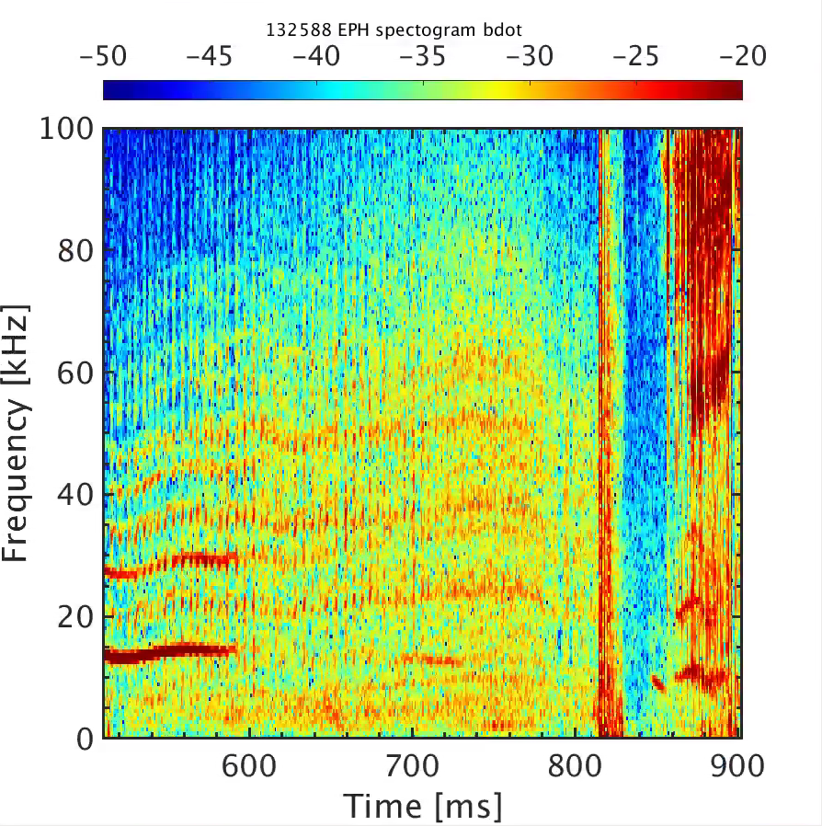
Example – NSTX 132588

Slide 6
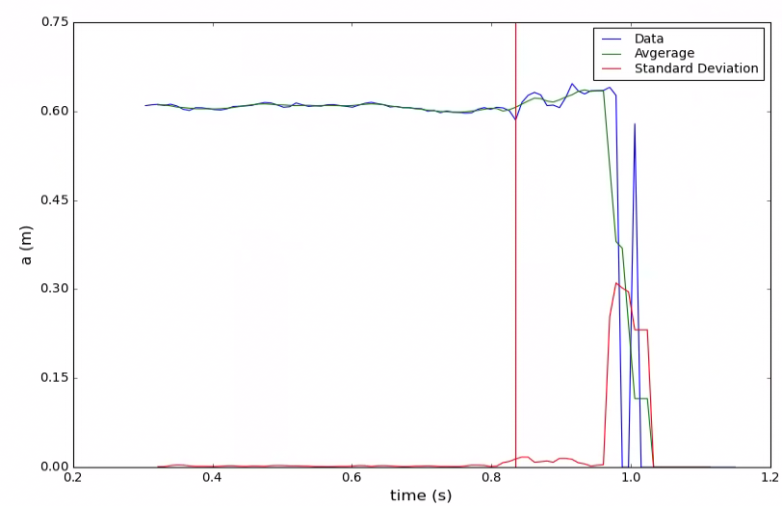
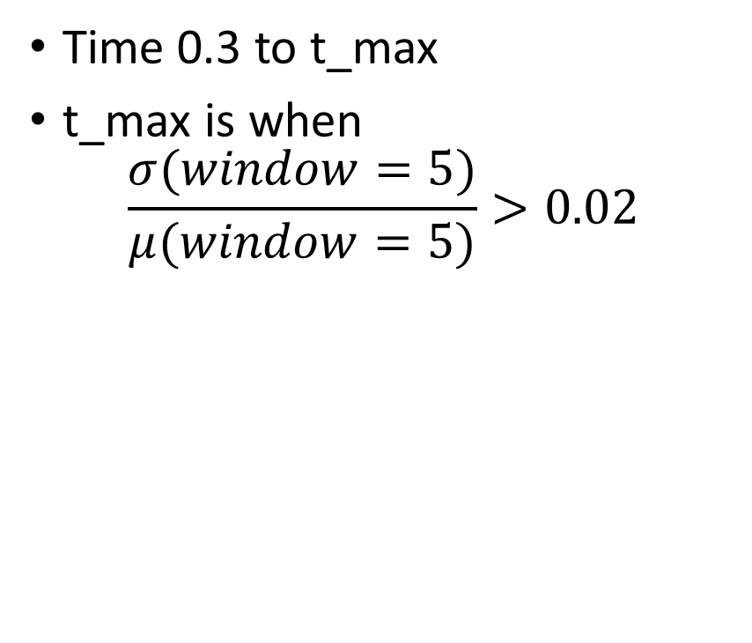
Cut off for time
Time 0.3 to t_max
t_max is when
$$\frac{σ(window=5)}{μ(window=5)}>0.02$$

Slide 7
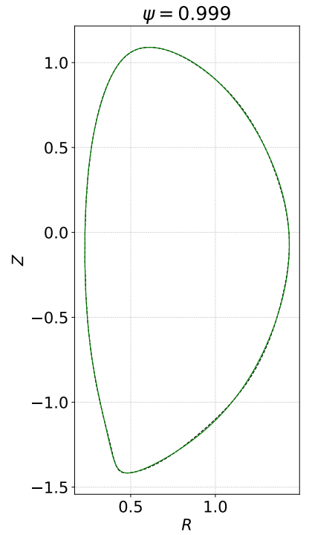
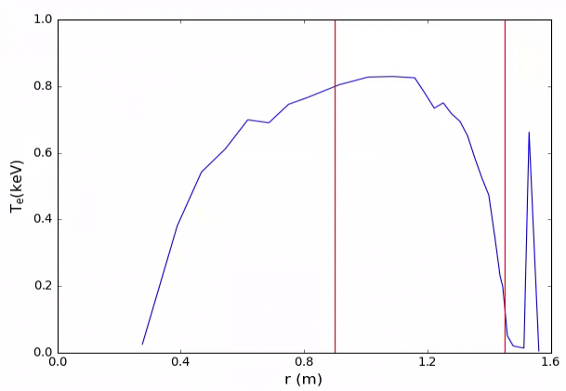
Cut off for R
R is 0.9 ~ 1.45

Slide 8
Cut off for R
R is 0.9 ~ 1.45

Slide 9
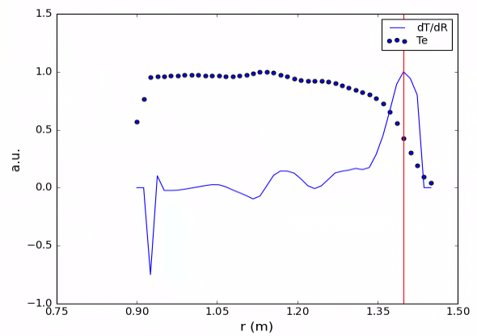
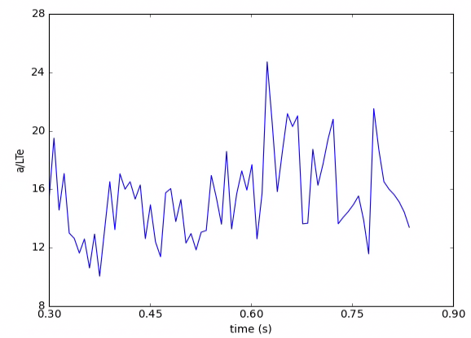
Finding pedestal
Take gradient and find the max

Slide 10
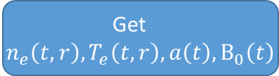
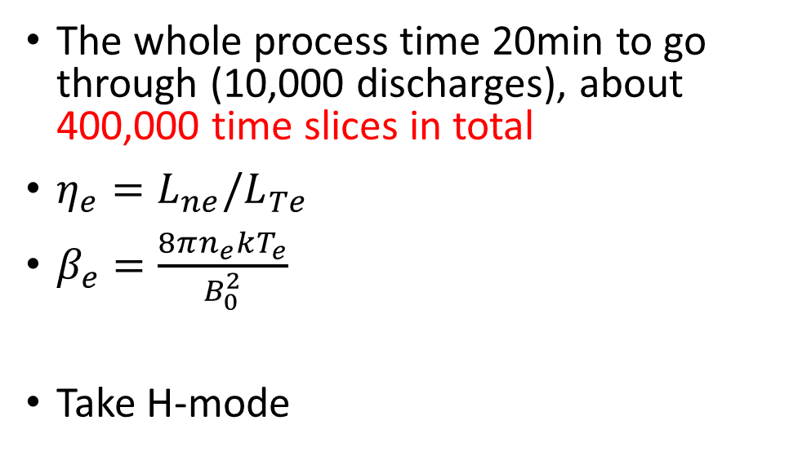
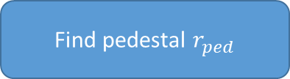
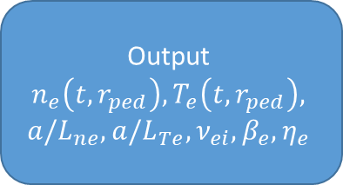
Work flow
Discharge
Get
$n_{e}\left(t,r\right), T_{e}\left(t,r\right),a\left(t\right),B_{0}\left(t\right)$
The whole process time 20min to go through (10,000 discharges), about 400,000 time slices in total
$η_{e}={L_{ne}/L}_{Te}$
$β_{e}=\frac{8πn_{e}kT_{e}}{B_{0}^{2}}$
Take H-mode
Cut R 0.9 ~ 1.45m
Choose the plateau time
Interpolate the time and radius to uniform coordinate
0.05s/shot
Calculate the
dn/dR, dT/dR
Find pedestal $r_{ped}$
Output
$$n_{e}\left(t,r_{ped}\right),T_{e}\left(t,r_{ped}\right),$$
$${a/L}_{ne},{a/L}_{Te}, ν_{ei}, β_{e}, η_{e}$$
Filter out the unusable data
Notes:
?

Slide 11
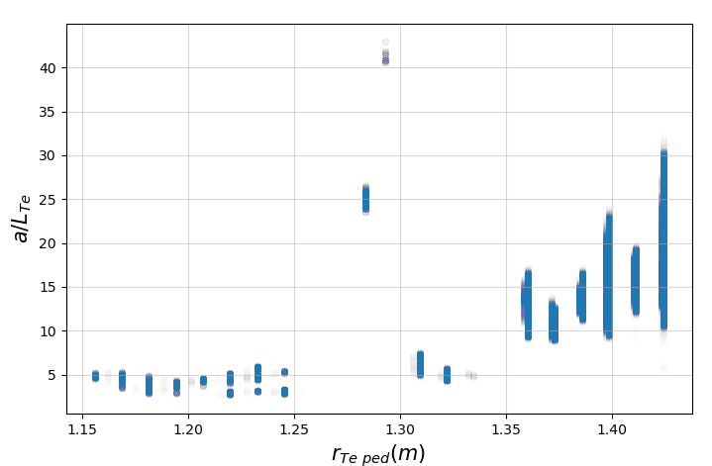
Spotting H-mode

Slide 12
Spotting H-mode

Slide 13
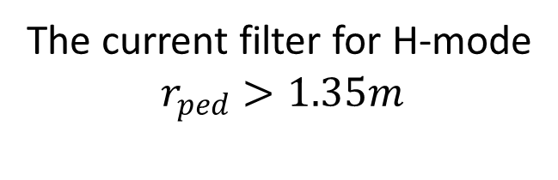
Spotting H-mode
The current filter for H-mode
$$r_{ped}>1.35m$$

Slide 14
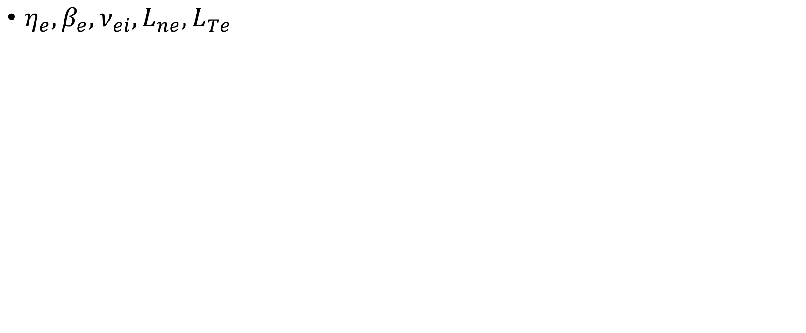
Quantities dependence
$η_{e}, β_{e}, ν_{ei},L_{ne}, L_{Te}$

Slide 15
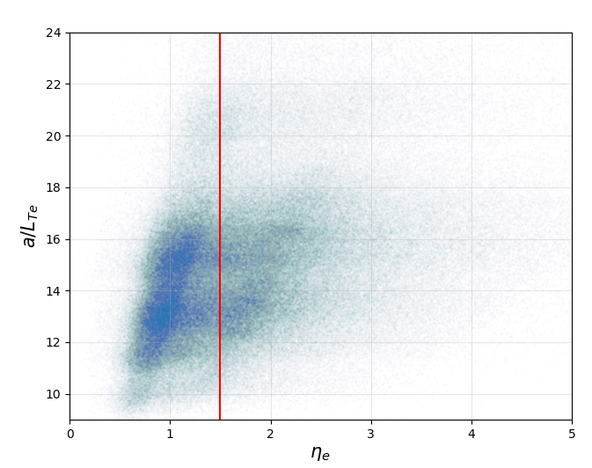
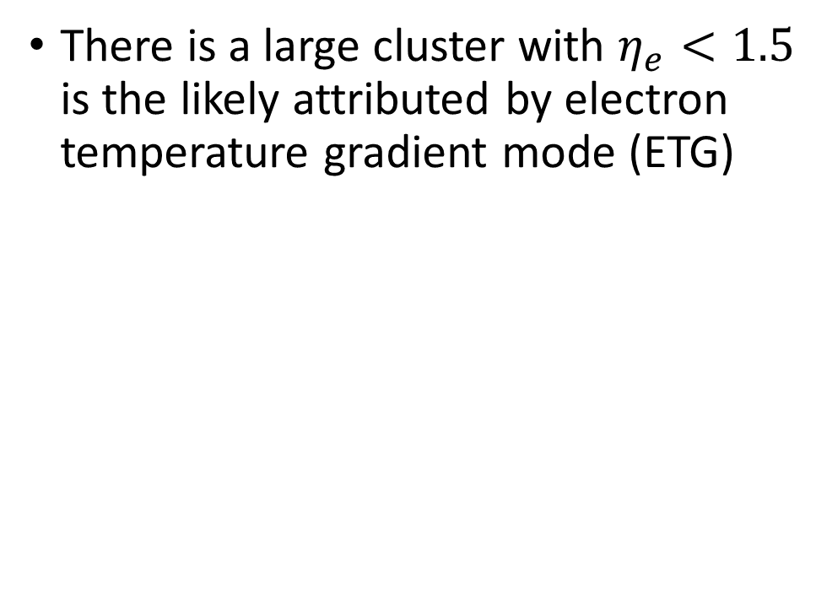
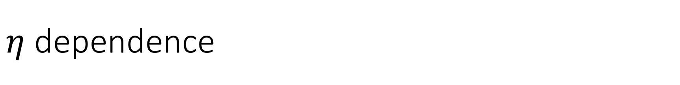
$η$ dependence
There is a large cluster with $η_{e}<1.5$ is the likely attributed by electron temperature gradient mode (ETG)

Slide 16
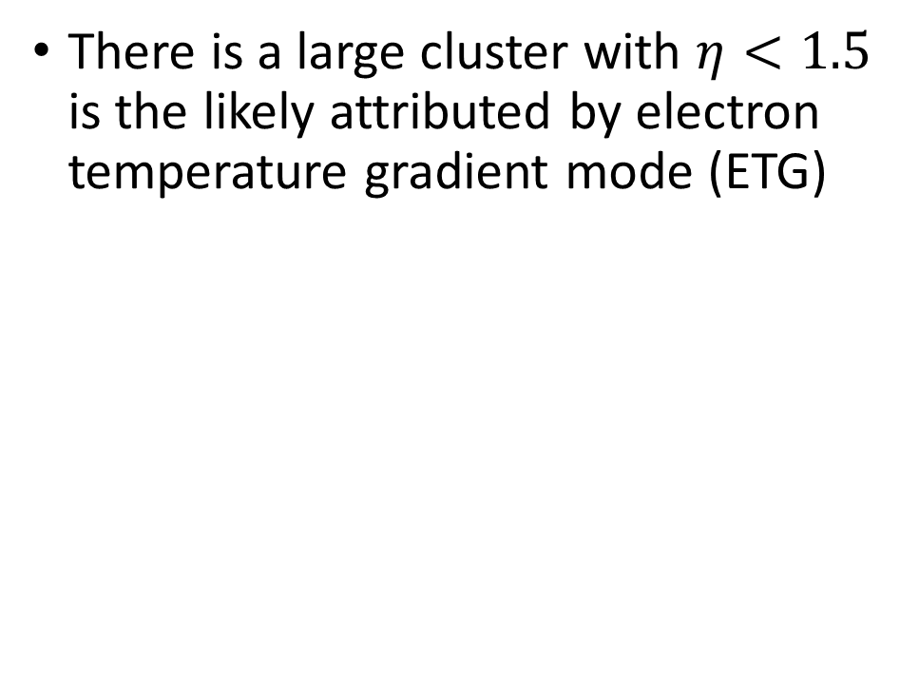
$η$ dependence
There is a large cluster with $η<1.5$ is the likely attributed by electron temperature gradient mode (ETG)

Slide 17
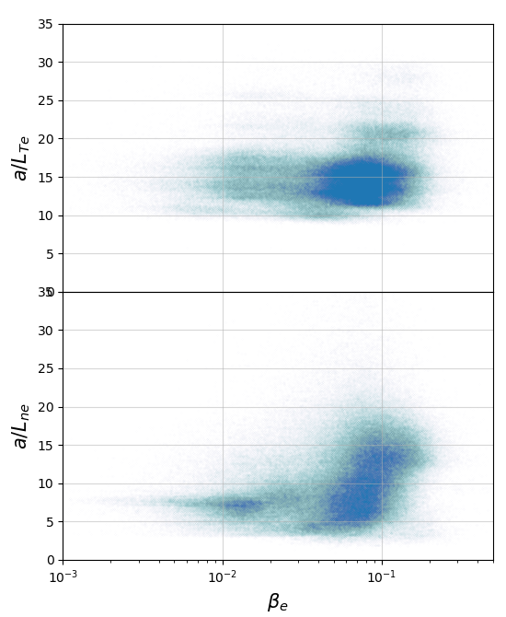
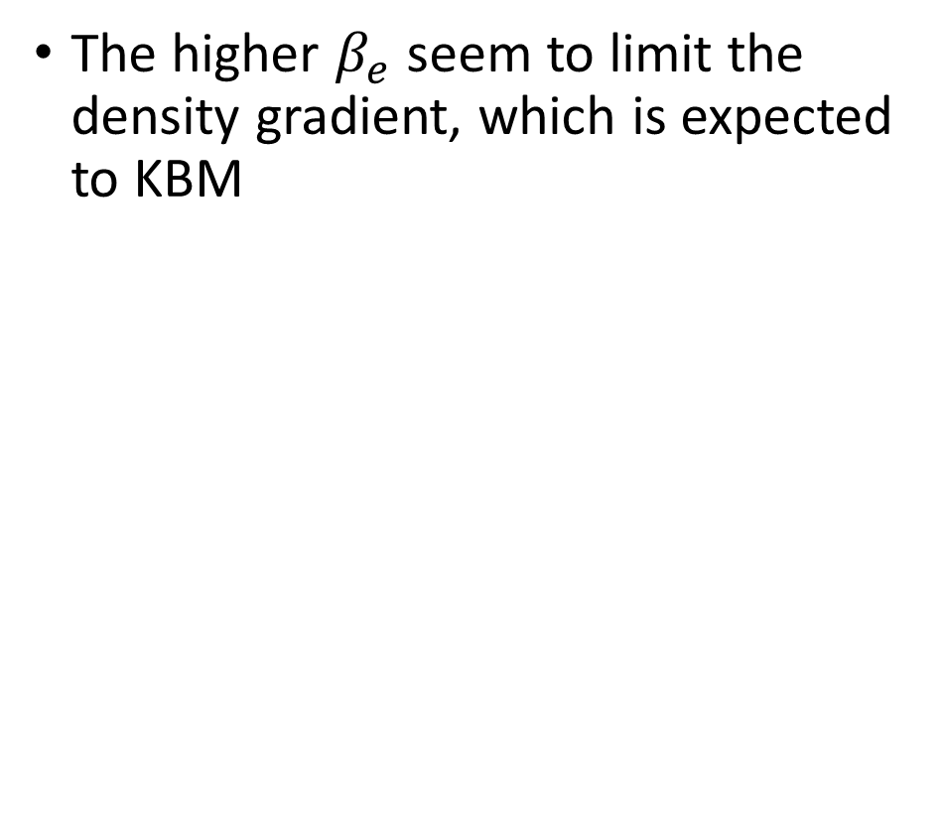
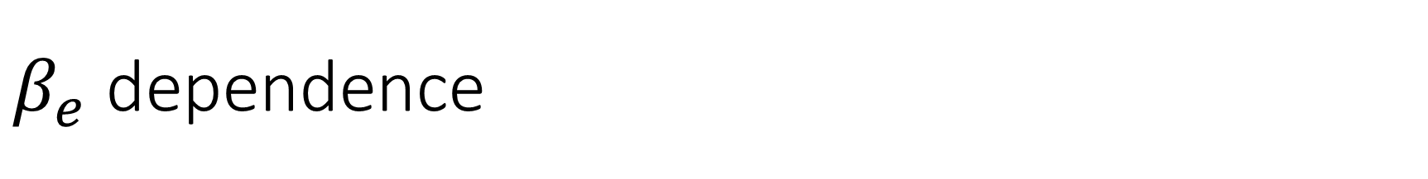
$β_{e}$ dependence
The higher $β_{e}$ seem to limit the density gradient, which is expected to KBM

Slide 18
$β_{e}$ dependence
The higher $β_{e}$ seem to limit the density gradient, which is expected to KBM

Slide 19
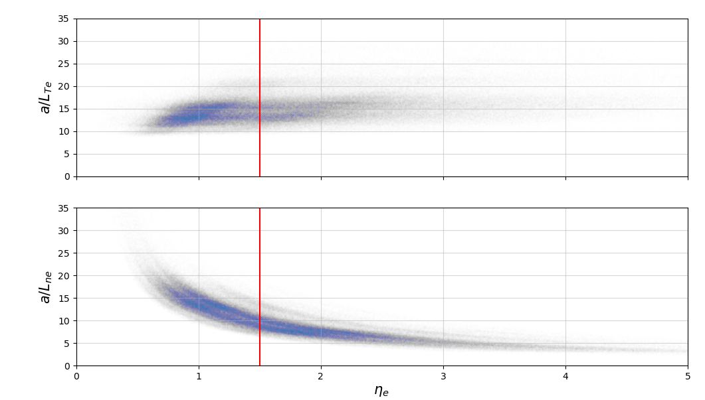
$β_{e}$ dependence
The higher $β_{e}$ seem to limit the density gradient, which is expected to KBM

Slide 20
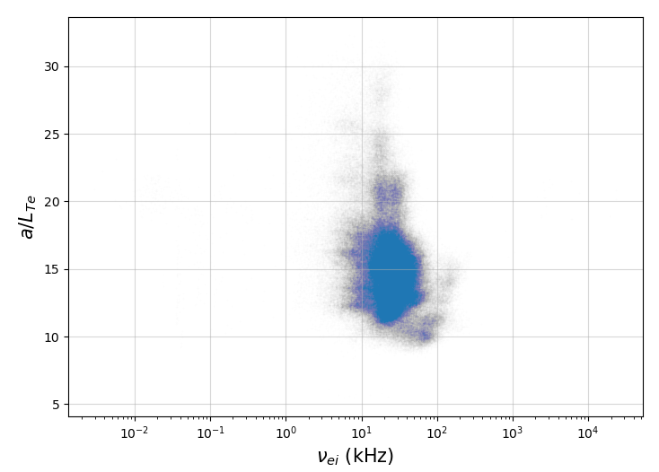
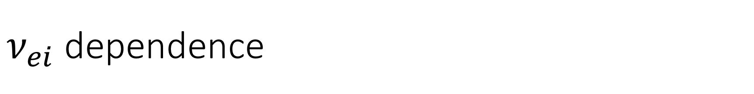
$ν_{ei}$ dependence

Slide 21
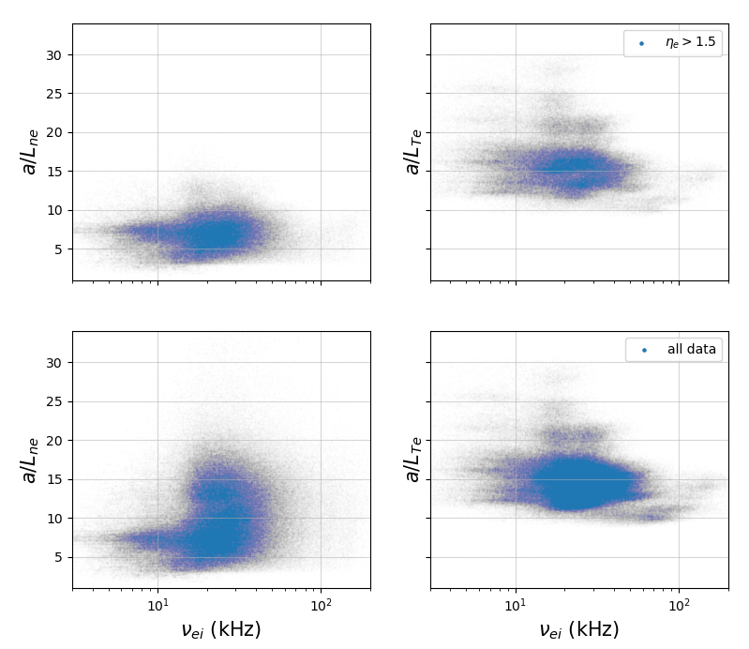
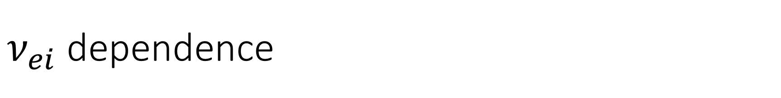
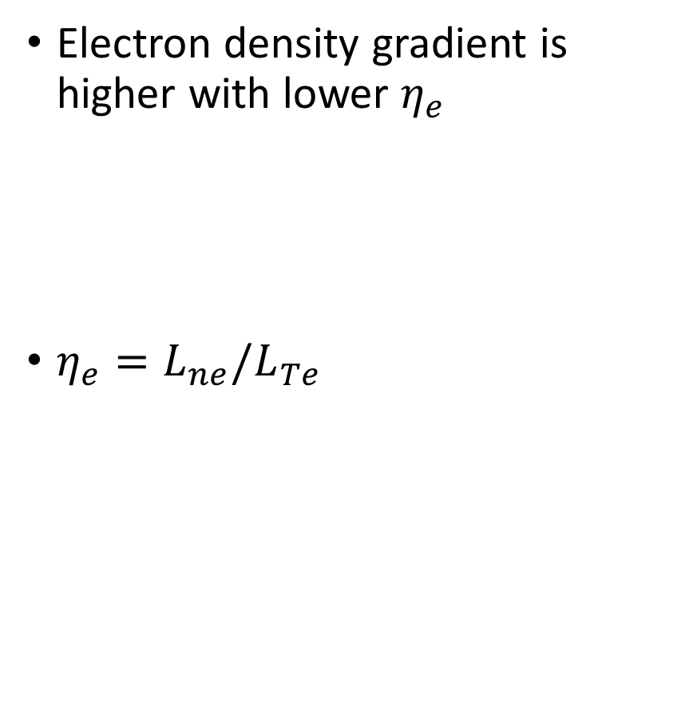
$ν_{ei}$ dependence
Electron density gradient is higher with lower $η_{e}$
$η_{e}={L_{ne}/L}_{Te}$

Slide 22
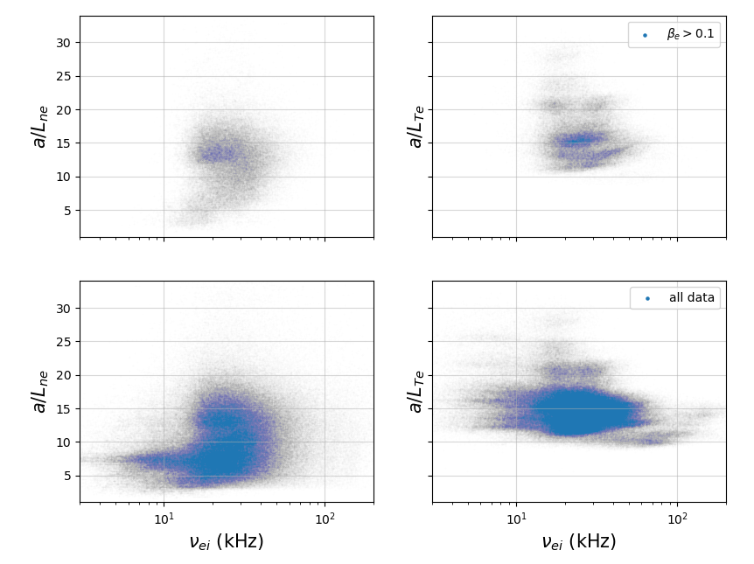
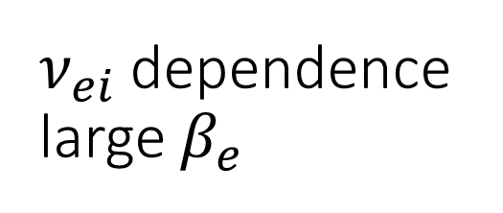
$ν_{ei}$ dependence large $β_{e}$
The large beta seems to have limited collision frequency at 20kHz, where we found strong magnetic signals in a dozen discharges

Slide 23
Summary
KBM and ETG can be found prevalence in the NSTX pedestal.
The MTM’s presents need further investigation.
Quantity | eat_e | beta_e | nu_ei | a/L_ne | a/L_Te
eat_e | -- |  |  | 0 | ETG
beta_e |  | -- |  | KBM | 0
nu_ei |  |  | -- | 0
a/L_ne |  |  |  | -- | 1
a/L_Te |  |  |  |  | --

Slide 24
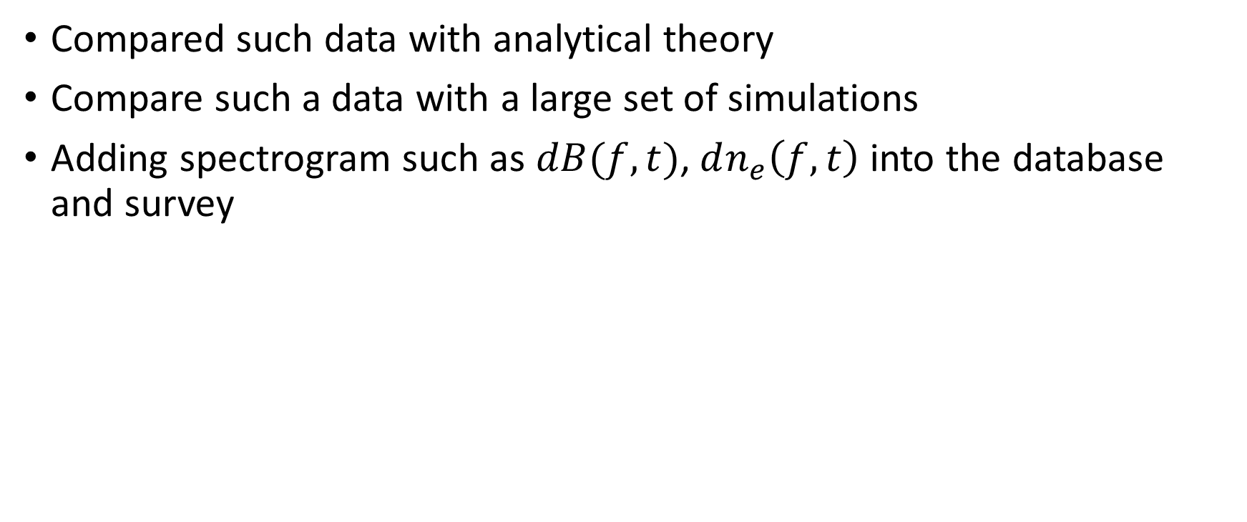
Future work
Compared such data with analytical theory
Compare such a data with a large set of simulations
Adding spectrogram such as $dB(f,t)$, $dn_{e}\left(f,t\right)$ into the database and survey

Slide 25
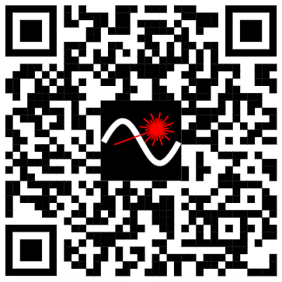

Links
GitHub
https://github.com/maxtcurie/NSTX_database
Presentation recording:
To be uploaded

Slide 26
Backup

Slide 27
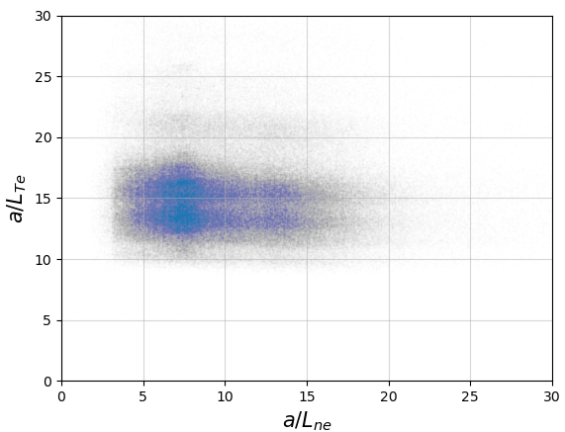

Slide 28
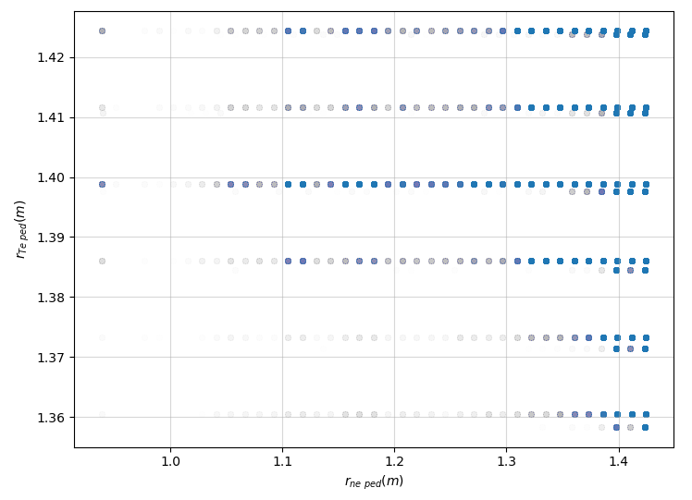

Slide 29
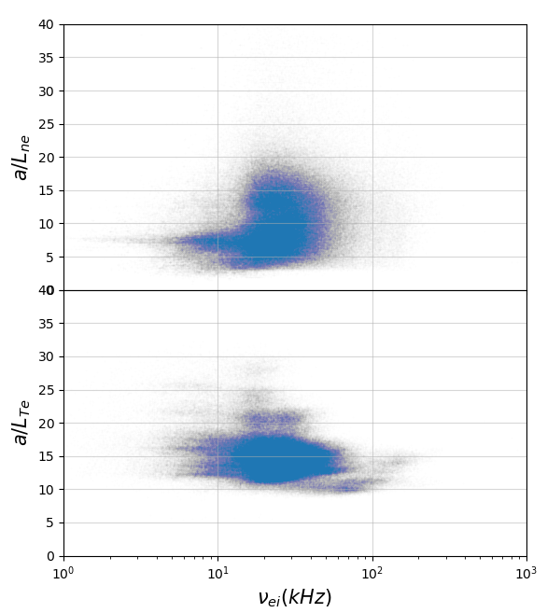
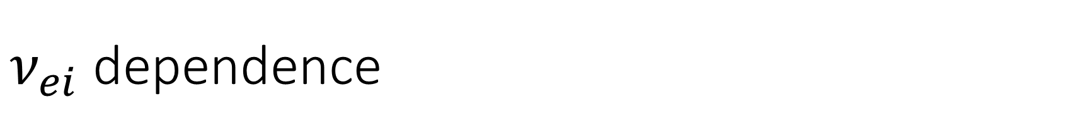
$ν_{ei}$ dependence

Slide 30
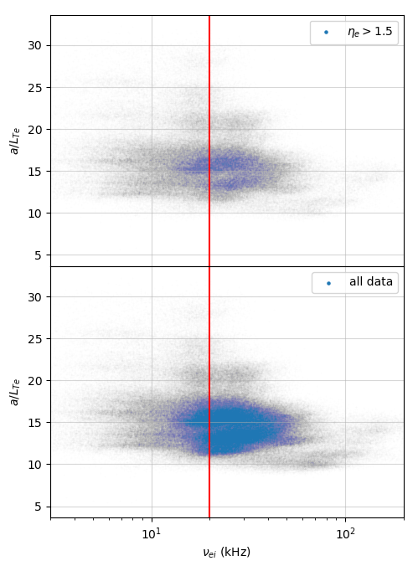
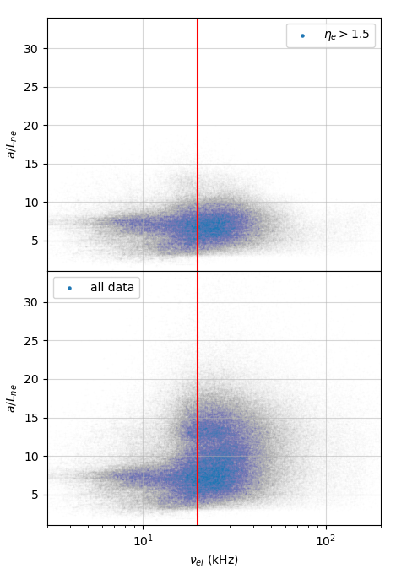
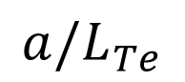
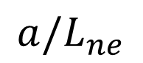
$$a/L_{Te}$$
$${a/L}_{ne}$$

Slide 31
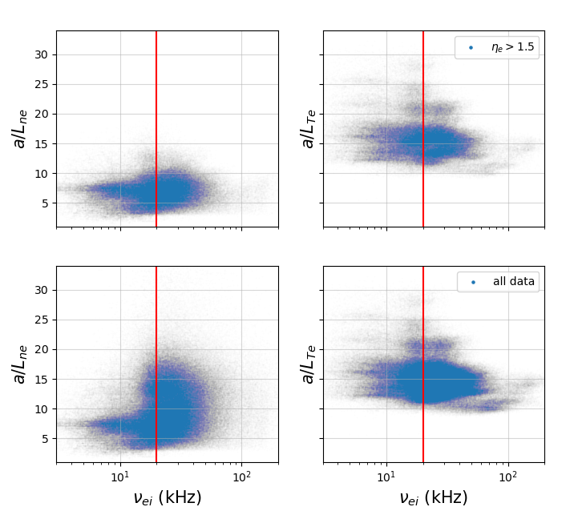

Slide 32
